Slide 1


Blockchain Cryptography
Public Key Cryptography, RSA, Encryption, Hashing, ECDSA, Signatures, Merkle Trees
Sevgin Mustafov
Blockchain Developer & Course Developer
Academy School of Blockchain
http://kingsland.academy

Slide 2


Table of Contents
What is Cryptography?
Symmetric and Asymmetric Encryption
Diffie-Hellman Key Exchange (DHKE)
The RSA Cryptosystem: Key Generation, Encrypt, Decrypt
Hashing, Cryptographic Hash Functions and SHA
Elliptic Curves and ECDSA: Key Generation, Sign, Verify
Blockchain Cryptography: Merkle Trees, Hashing the Blocks, Understanding the Bitcoin Addresses, Wallets

Slide 3

What is Cryptography?
Encryption, Keys, Hashing, Signatures

Slide 4

What is Cryptography?
Cryptography is the science of providing security for information
Storing and transmitting data in a secure way
Only those, for whom it is intended, can read and process it
Encrypting and decrypting data (symmetric / asymmetric)
Key-exchange algorithms, key derivation
Hashing data (message digest)
Digital signatures (sign / verify)

Slide 5

Symmetric / Asymmetric Encryption
Symmetric Encryption
Asymmetric Encryption
vs.

Slide 6
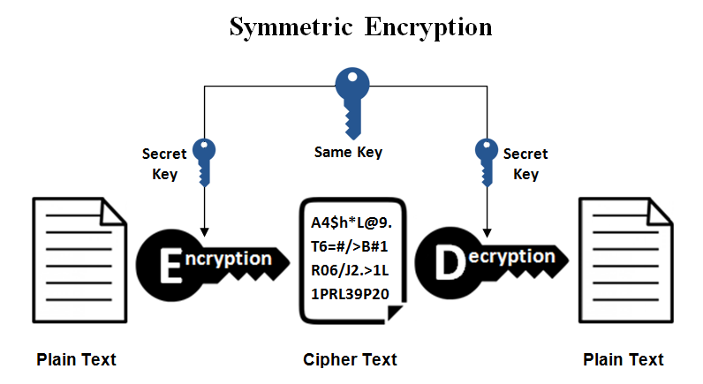
Symmetric Encryption
A single secret key to cipher / decipher
The secret key can be a number or string
Both the sender and the recipient should know the secret key
Widely used symmetric algorithms: AES-128, AES-256, Twofish, IDEA

Slide 7
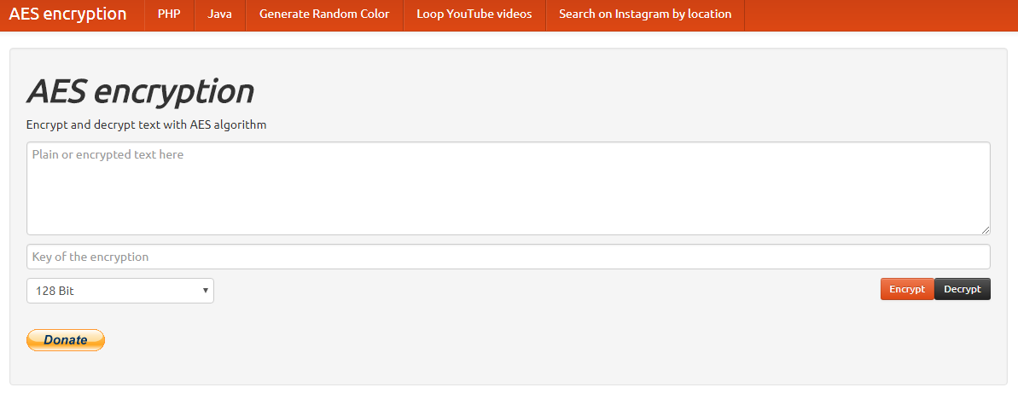
Live Demo
AES Encrypt / Decrypt: https://aesencryption.net

Slide 8
Example: AES Encrypt / Decrypt
import base64
from Crypto import Random
from Crypto.Cipher import AES
BS = 16
pad = lambda s: s + (BS - len(s) % BS) * chr(BS - len(s) % BS)
unpad = lambda s : s[0:-ord(s[-1])]
…

Slide 9
Example: AES Encrypt / Decrypt (2)
class AESCipher:
def __init__(self, key):
self.key = key
def encrypt(self, raw):
raw = pad(raw)
iv = Random.new().read(AES.block_size)
cipher = AES.new(self.key, AES.MODE_CBC, iv)
return base64.b64encode(iv + cipher.encrypt(raw))
def decrypt(self, enc):
enc = base64.b64decode(enc)
iv = enc[:16]
cipher = AES.new(self.key, AES.MODE_CBC, iv)
return unpad(cipher.decrypt(enc[16:]))

Slide 10
Example: AES Encrypt / Decrypt (3) - Test
cipher = AESCipher('mysecretpassword')
encrypted = cipher.encrypt('Secret Message A')
decrypted = cipher.decrypt(encrypted)
print encrypted
print decryptediv

Slide 11
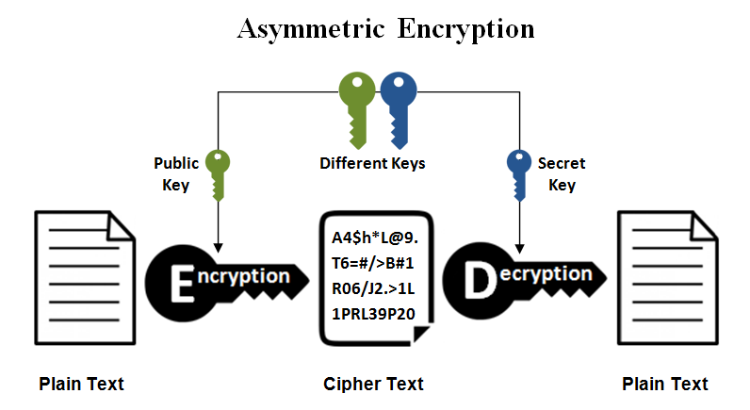
Asymmetric Encryption
Public-key cryptography:
Use public / private keys to encrypt / decrypt data
The public key can be shared with everyone
The private key is kept secret
Encrypt a message using the public key
Decrypt the message only with the private key
Popular asymmetric algorithms: RSA, EIGamal, DSA, Elliptic Curve DSA

Slide 12
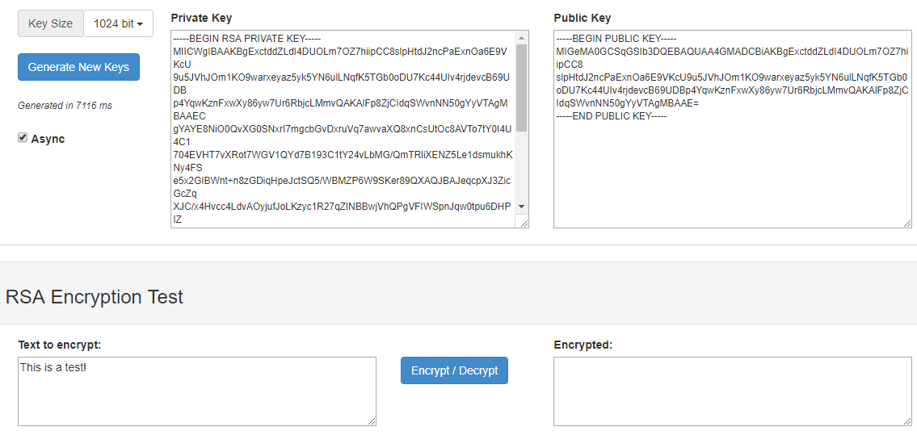
Live Demo
JSEncrypt (Generate RSA Keys and Encrypt): http://travistidwell.com/jsencrypt/demo/

Slide 13
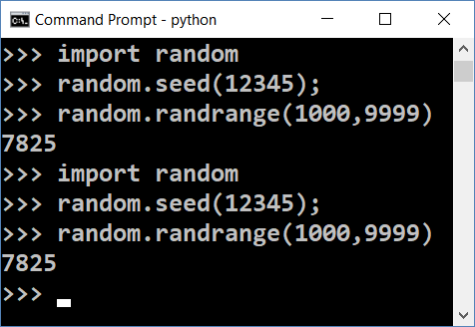
Random Generators and Cryptography
In computer science random numbers come from a pseudo-random number generator (PRNG)
Consists of initial randomness (seed) + pseudo-random function
To be secure, a PRNG should start by a truly random initial seed
Known seed generates predictable random numbers → insecure
Insecure randomness can compromise cryptography
The stolen Bitcoins story: https://goo.gl/PFE1kr

Slide 14
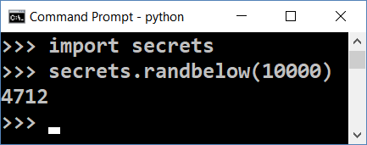
Secure Random Generators (CSPRNG)
Cryptography secure random generators (CSPRNG) guarantee that the random numbers are absolutely unpredictable
E.g. hardware devices (TRNG) capturing physical processes
CSPRNG should start from a truly random seed
Modern OS collect entropy (seed) from keyboard clicks, mouse moves, network activity, etc.
Accessible from /dev/random and /dev/urandom
In Python use the secrets library

Slide 15
Internal Seed in Crypto Wallets
Most modern crypto wallets start from a 128 / 256 bits securely generated random seed (see the BIP-39 standard)
The seed (root key) can be represented by 12 or 24 words
Each word comes from a wordlist of 2048 words
See https://github.com/bitcoin/bips/blob/master/bip-0039/english.txt
1 word == 11 bits
12 words == 132 bits == 128-bit seed + checksum (in the last word)
24 words == 264 bits == 256-bit seed + checksum (in the last word)
hill brave science fox crime quit owner chapter myth vocal chat custom

Slide 16
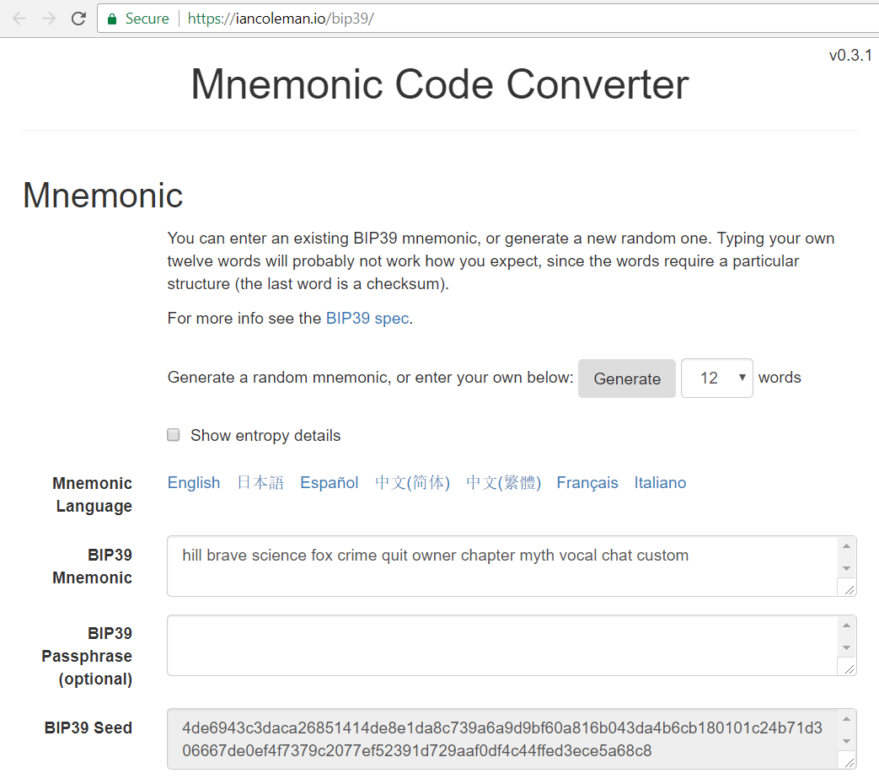
BIP-39 Mnemonic Seed Generator
Live Demo
https://iancoleman.io/bip39

Slide 17
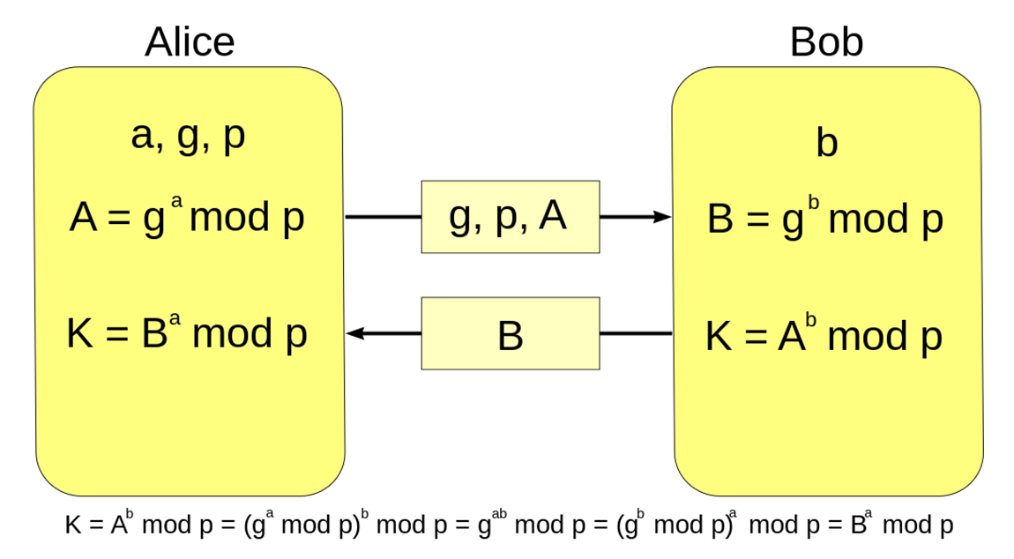
Diffie-Hellman Key Exchange (DH)
Diffie-Hellman and Module Arithmetic

Slide 18

Diffie–Hellman Key Exchange (DH)
Securely exchanging cryptographic keys
Over a public (insecure) channel
One of the first public-key protocols
Allows two parties to exchange data securely
The Diffie–Hellman (DH) method allows
Two parties that have no prior knowledge of each other
Jointly establish a shared secret key over an insecure channel

Slide 19
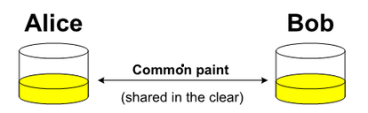

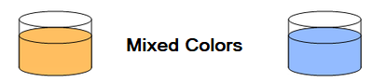
Key Exchange by Mixing Colors
Alice and Bob, agree on an arbitrary starting color that does not need to be kept secret
Each of them selects a secret color that they keep to themselves
Finally Alice and Bob mix their secret color together with their mutually shared color

Slide 20
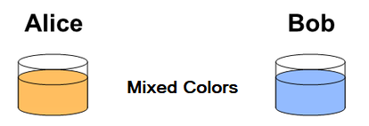
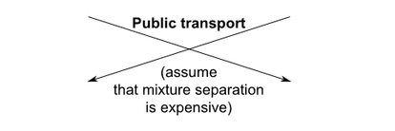
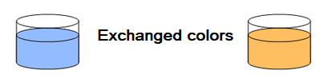
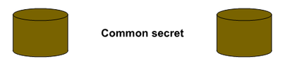
Key Exchange by Mixing Colors (2)
Publicly exchange the two mixed colors
Finally, each of the two mix together the color they received from the partner with their own private color
The result is a final color mixture yellow-brown that is identical to the partner's color mixture
If a third party listened to the exchange, it would be computationally difficult for them to determine the secret colors

Slide 21
DH Key Exchange: Modular Arithmetic
Alice and Bob agree to use a modulus p = 23 and base g = 5
Alice chooses a secret integer a = 4, then sends Bob A = gª mod p
A = 5⁴ mod 23 = 4
Bob chooses a secret integer b = 3, then sends Alice B = g^{b} mod p
B = 5³ mod 23 = 10
Alice computes s = Bª mod p
s = 10⁴ mod 23 = 18
Bob computes s = A^{b} mod p
s = 4³ mod 23 = 18
Alice and Bob now share a secret number s
s = (gª)^{b} mod p = (g^{b})ª mod p
s = 18
s cannot be computed from A and B
Video: youtu.be/M-0qt6tdHzk

Slide 22
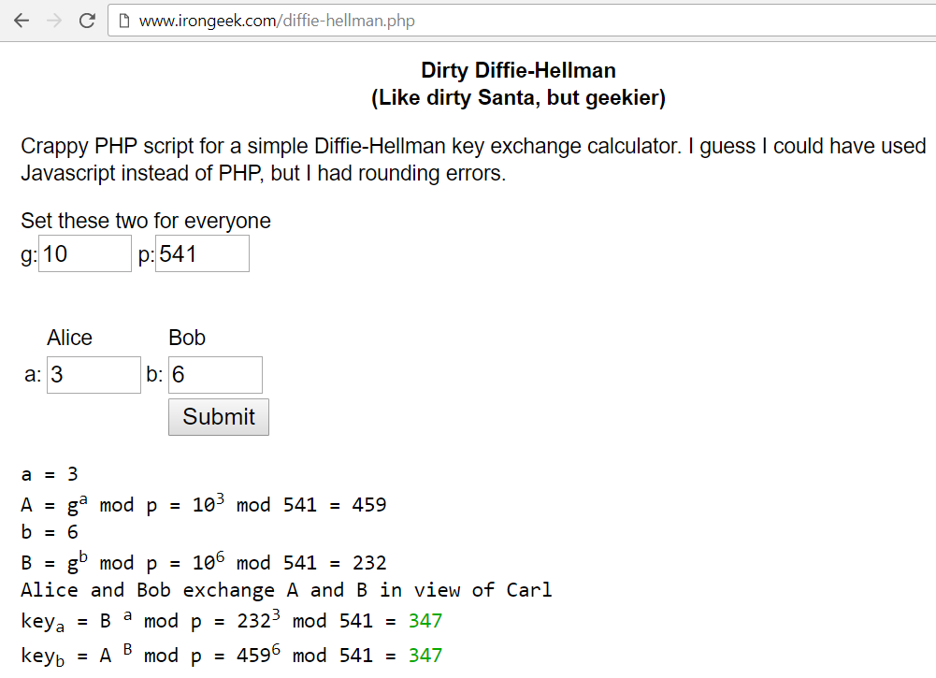
Diffie-Hellman Key Exchange
Live Demo
http://www.irongeek.com/diffie-hellman.php

Slide 23

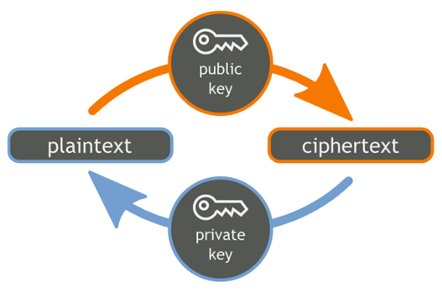
RSA Cryptography
RSA
RSA Key Generation, Encryption, Decryption

Slide 24
RSA Cryptography
RSA (Rivest–Shamir–Adleman) is public-key cryptosystem
Based on big integers and modular exponentiation
Developed by MIT, widely used in computer cryptography
Generate RSA public / private key pair
Find very large integers e, d and n, such that:
(m^{e})^{d} ≡ m (mod n) for all m for 0 ≤ m < n
public key = {n, e} → shared with everyone
private key = {n, d} → secret, cannot be calculated from {n, e}

Slide 25


RSA Cryptography: Encrypt / Decrypt
Encrypt a message with RSA public key {n, e}
encrypted = (message)^{e} mod n
Decrypt a message with RSA private key {n, d}
message = (encrypted)^{d} mod n
Recall that (m^{e})^{d} ≡ m (mod n)
No efficient algorithm exists for integer factorization
If you are given n, you cannot find its factorization n = p*q
No efficient algorithm to calculate {n, d} from {n, e}

Slide 26
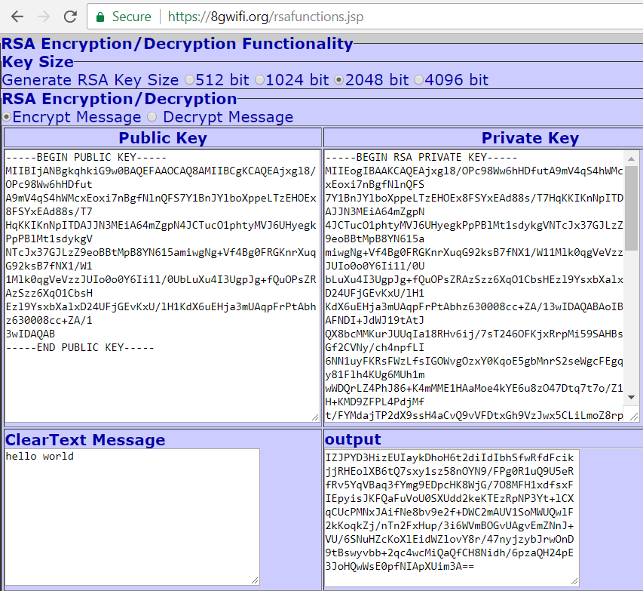
RSA Encrypt and Decrypt
Live Demo
https://8gwifi.org/rsafunctions.jsp

Slide 27
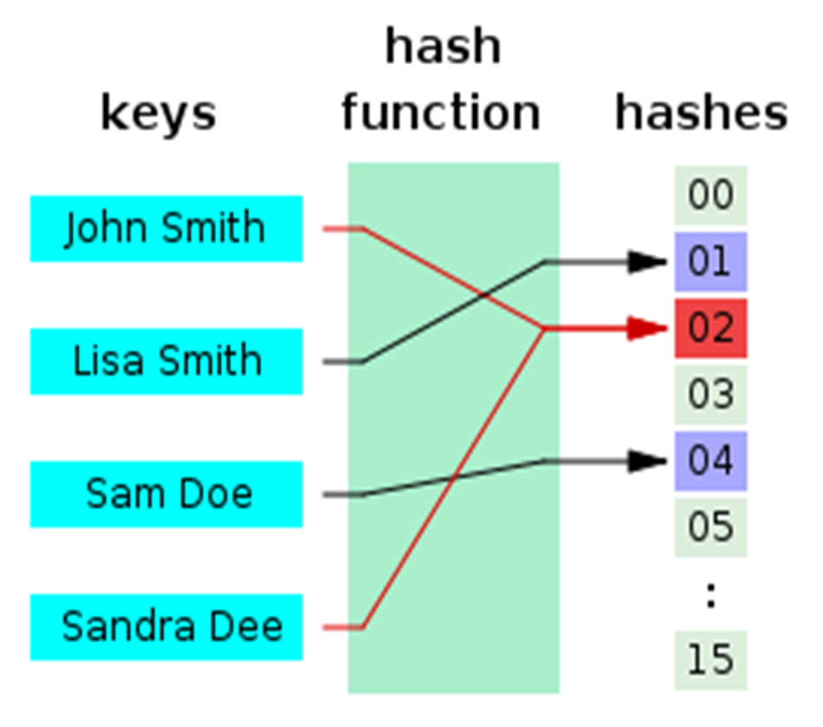
Hashing and Hash Functions
Cryptographic Hash Functions

Slide 28

What is Hashing?
Text
Hashed text
Some text
Some text
Some text
Some text
Some text
Some text
Some text
20c9ad97c081d63397d7b685a412227a40e23c8bdc6688c6f37e97cfbc22d2b4d1db1510d8f61e6a8866ad7f0e17c02b14182d37ea7c3c8b9c2683aeb6b733a1
Hash function

Slide 29
Hash Functions
Hash functions:
Map data of arbitrary size input to result of fixed size
Returned result is called hash value, hash code, digests, or simply hash
Irreversible by design
Cannot reproduce the input from the result
Used in cryptography and in programming

Slide 30
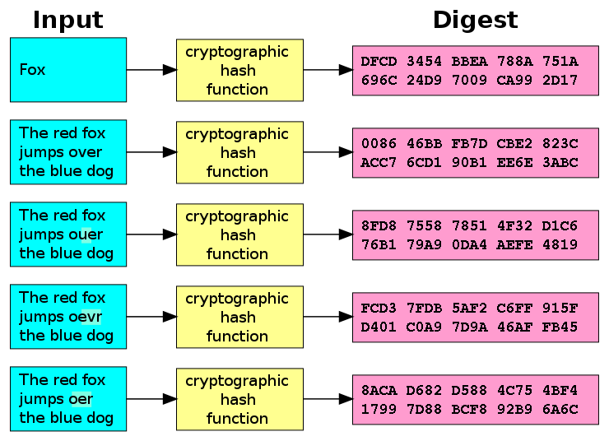
Cryptographic Hash Function
Cryptographic hash function
One-way hash function
Infeasible to invert
Extremely little chance to find a collision
Let's have hash(p)
It should be extremely hard to find an input p', such that hash(p') = p

Slide 31

The Ideal Cryptographic Hash Function
Deterministic
The same message always results in the same hash
Quick
Fast to compute the hash value for any given message
Small change to a message changes totally the hash value
Irreversible
Generate a message from its hash value is infeasible
No significantly better way than brute force (try all messages)
No collisions: cannot find two different messages with the same hash

Slide 32
Cryptographic Hash Functions: Applications
Verifying the integrity of files / documents / messages
E.g. SHA256 checksum may confirm that certain file is original
Password storing and verification
Keep in the DB password hashes instead of clear text passwords
Generate an almost unique ID of certain document / message
Pseudorandom generation and key derivation
Proof-of-work (PoW) algorithms
Find a number p, such that hash(x + p) holds 10 leading zeroes

Slide 33
Secure Hash Algorithms
Old hash algorithms: MD5, SHA-0, SHA-1
Withdrawn due to cryptographic weaknesses
SHA-2
Family of functions: SHA-256 (256 bits hash), SHA-512 (512 bits), …
SHA-3
More secure, same hash length (256 bits), known as "Keccak"
RIPEMD-160
Secure hash function, widely used in cryptography, e.g. PGP, Bitcoin
Less secure variations: RIPEMD-128 , RIPEMD-256, RIPEMD-320

Slide 34
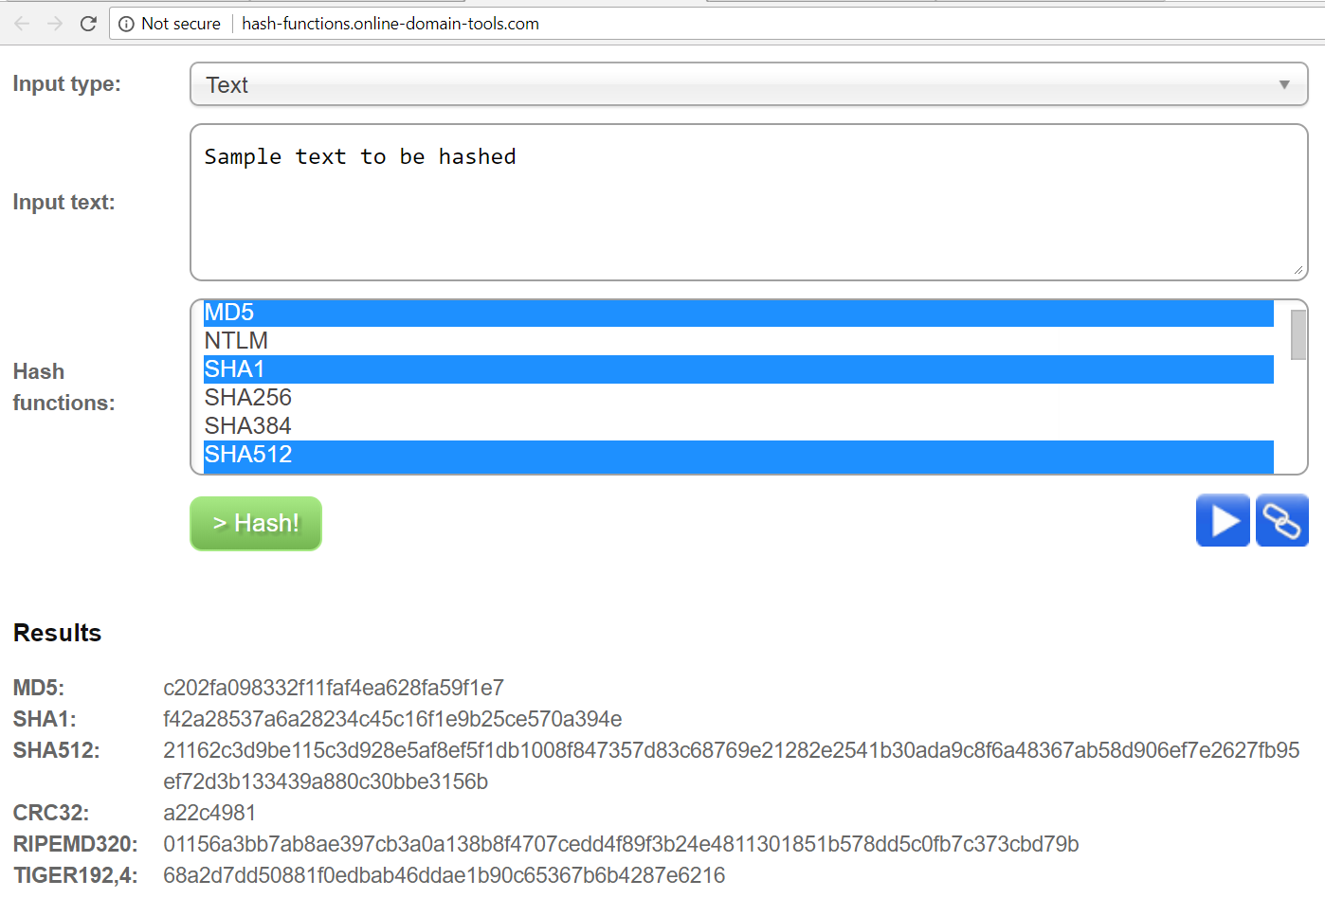
Live Demo
Play with Hash Functions Online
http://hash-functions.online-domain-tools.com

Slide 35
ETHash
Native proof-of-work function for the Ethereum blockchain
Alternative to SHA3-256 and SHA3-512
How it works?
Seed is computed for each block
From the seed, one can compute a 16 MB pseudorandom cache
Light clients store the cache
From the cache, generate a 1 GB dataset
Mining involves grabbing random slices of the dataset and hashing them together

Slide 36
HMAC and Key Derivation
HMAC = Hash-based Message Authentication Code
Message hash mixed with a secret shared key
Used for message authenticity / integrity / key derivation
HMAC(key, msg, hash_func) → hash
Simply calculating hash_func(key || msg) is insecure
Use a secure HMAC algorithm instead, e.g. HMAC-SHA256
Key derivation
Use HKDF (key derivation based on HMAC) or PBKDF2

Slide 37
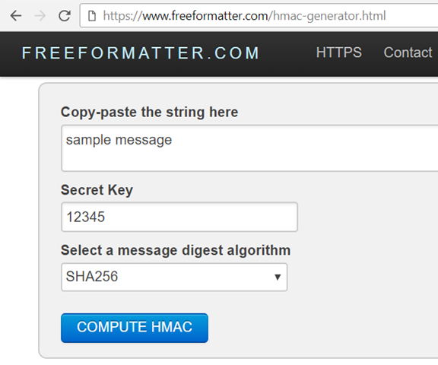
HMAC
Live Demo
https://www.freeformatter.com/hmac-generator.html

Slide 38
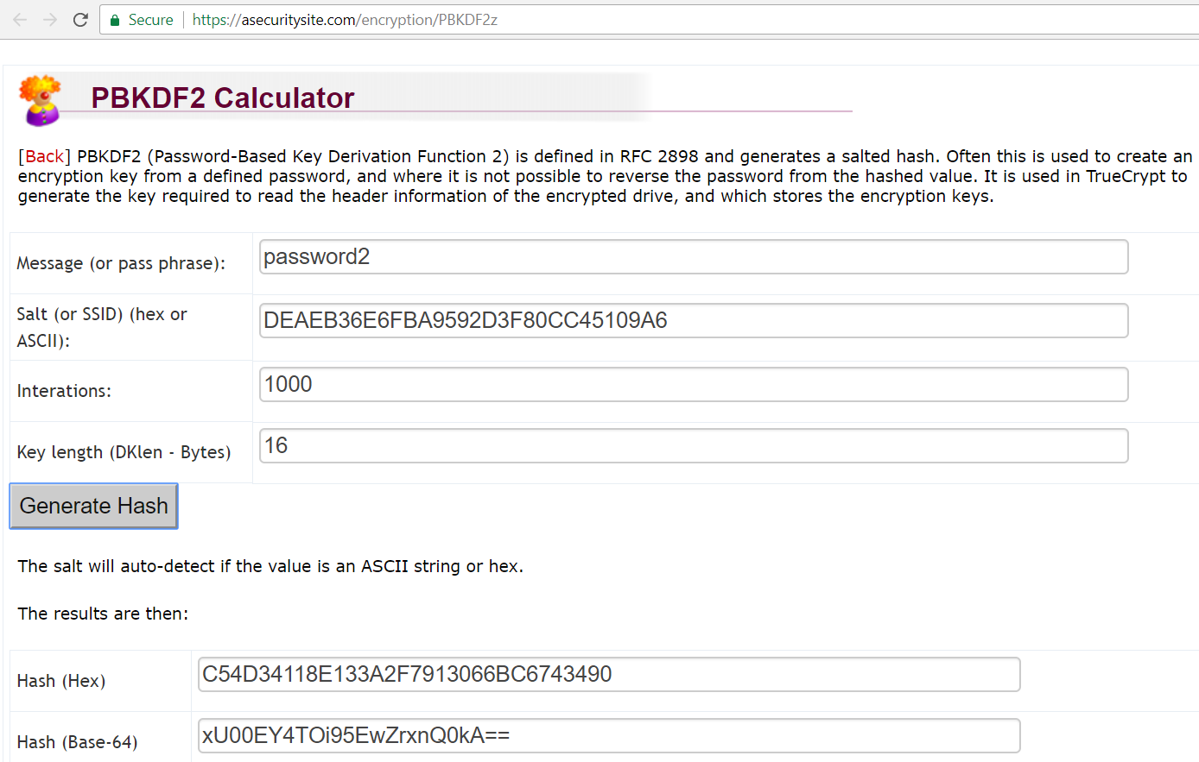
PBKDF2 Key Derivation
Live Demo
https://asecuritysite.com/encryption/PBKDF2z

Slide 39
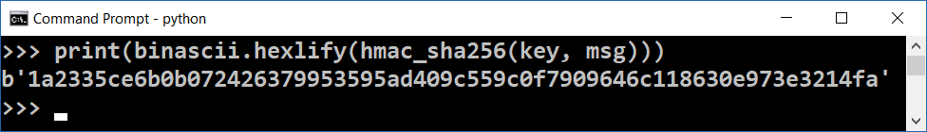
HMAC Calculation in Python – Example
import hashlib, hmac, binascii
def hmac_sha256(key, msg):
return hmac.new(key, msg, hashlib.sha256).digest()
key = binascii.unhexlify("FA63F2B4C85AF6BED3")
msg = "some message".encode("utf8")
print(binascii.hexlify(hmac_sha256(key, msg)))

Slide 40
HKDF Calculation in Python – Example
import hashlib, hmac, math, binascii
def derive_key_hkdf(password, target_key_length = 128,
hash_func = hashlib.sha256, salt = b"", info = b""):
key = hmac.new(salt, password, hash_func).digest()
hash_len = hash_func().digest_size
result, t = b"", b""
for i in range(math.ceil(target_key_length / hash_len)):
t = hmac.new(key, t + info + bytes([1 + i])).digest()
result += t
return result[:target_key_length]
password = "M1S3cr3tP@$$w0rd".encode("utf8")
print(binascii.hexlify(derive_key_hkdf(password, 50)))

Slide 41
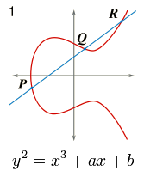
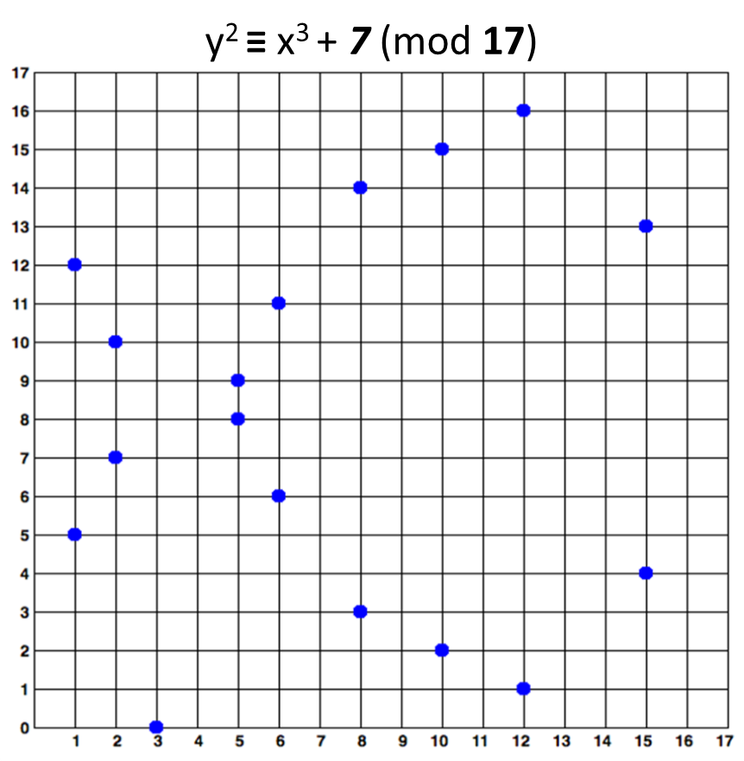
Elliptic Curve Cryptography (ECC)
Elliptic Curves, ECC and ECDSA, Sign, Verify

Slide 42
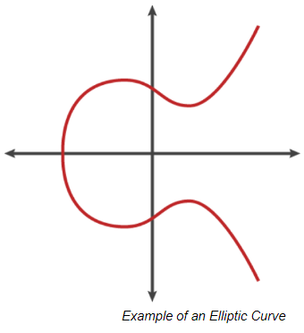
Elliptic Curve Cryptography (ECC)
Public / private key cryptography based on the algebraic structure of elliptic curves over finite fields
Requires smaller key-size than RSA for the same security strength
Elliptic curves == set of points {x, y} such that:
y² = x³ + ax + b
Example – the Bitcoin elliptic curve:
y² = x³ + 7 (a = 0; b = 7)

Slide 43
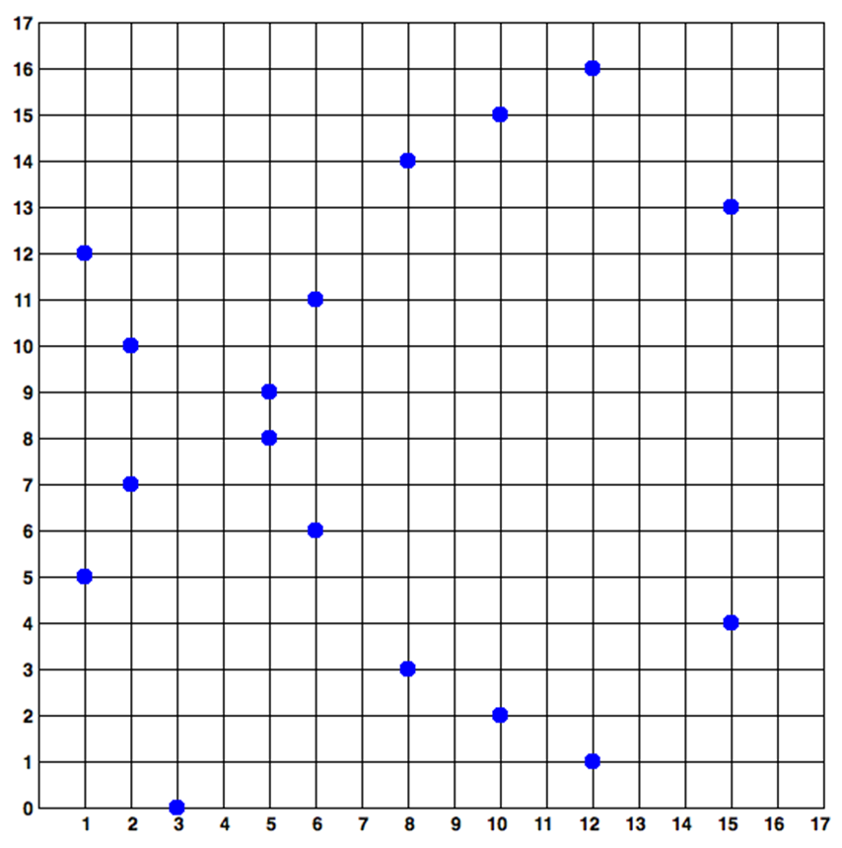
Elliptic Curves over a Finite Fields
Elliptic curves cryptography (ECC)
Uses ecliptic curves over the finite field F_{p} (p is prime, p > 3)
A set of integer coordinates {x, y}, such that 0 ≤ x, y < p
Staying on the elliptic curve: y² ≡ x³ + ax + b (mod p)
Example of elliptic curve over F₁₇:
y² ≡ x³ + 7 (mod 17)
y² ≡ x³ + 7 (mod 17)

Slide 44
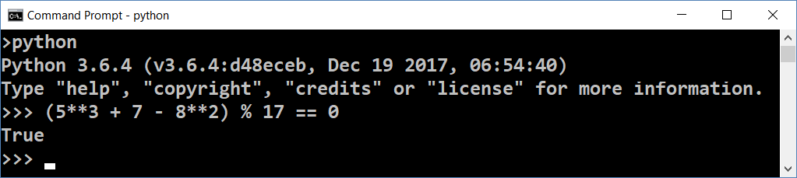
Calculating Elliptic Curves over Finite Fields
y² ≡ x³ + 7 (mod 17)
The point P(5, 8) is on the curve y² = x³ + 7 over the finite field F₁₇
(x³ + 7 - y²) ≡ 0 (mod 17)
(5**3 + 7 - 8**2) % 17 == 0
P

Slide 45
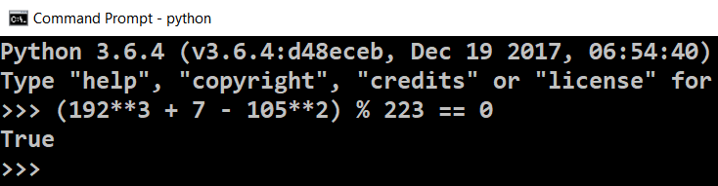
Exercise: Elliptic Curves over Finite Fields
Problem: True or False?
Point is on the y² = x³ + 7 curve over F₂₂₃
(192, 105)
(17, 56)
(200, 119)
(1, 193)
(42, 99)
Solution of y²=x³+7 curve over F₂₂₃
Just calculate the expression:
(192**3 + 7 - 105**2) % 223 == 0

Slide 46
Multiply a Point Over an Elliptic Curve
y² ≡ x³ + 7 (mod 17)
A point G over the curve can be multiplied by an integer k
P = k * G
The result is another point P staying on the same curve
k == private key (integer)
P == public key (point)
Very fast to calculate P = k * G
Extremely slow (considered infeasible) to calculate k = P / G
P
G

Slide 47
Example: Multiply Points Over Elliptic Curves
Elliptic curve point multiplication is done by well-known algorithms
Sample elliptic curve:
y² ≡ x³ + 7 (mod 17)
a = 0; b = 7; p = 17
Let G = (15, 13)
G₂ = 2 * G = (2, 10)
G₃ = 3 * G = (8, 3)
y² ≡ x³ + 7 (mod 17)
G
G₂
G₃

Slide 48
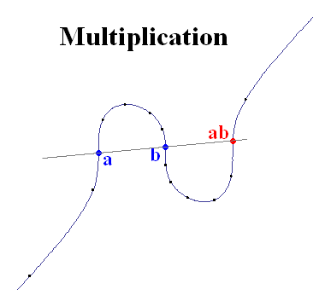
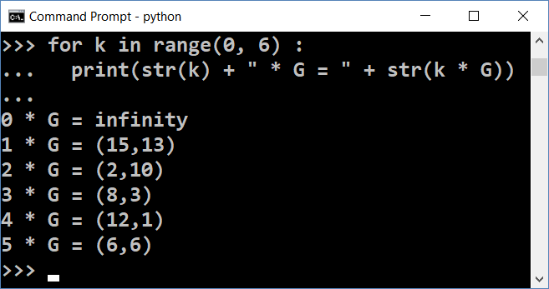
Elliptic Curves Multiplication in Python
pip install pycoin
from pycoin.ecdsa import Point
from pycoin.ecdsa import CurveFp
curve = CurveFp(17, 0, 7)
print("Curve = " + str(curve))
G = Point(curve, 15, 13)
print("G = " + str(G))
for k in range(0, 6) :
print(str(k) + " * G = " + str(k * G))

Slide 49
Compressing the Public Key
The elliptic curves over F_{p}
Have at most 2 points per y coordinate (odd x and even x)
A public key P(x, y) can be compressed as C(x, odd/even)
At the curve y² ≡ x³ + 7 (mod 17)
P(10, 15) == C(10, odd)
mod_sqrt(x³ + 7, 17) == y || 17 - y
y² ≡ x³ + 7 (mod 17)

Slide 50
Compressing a Public Key in Python
from pycoin.ecdsa import CurveFp, Point
from nummaster.basic import sqrtmod
def compress_key_pair(key_pair):
return (key_pair.x(), key_pair.y() % 2)
def uncompress_key(curve, compressed_key):
x, is_odd = compressed_key
p, a, b = curve.p(), curve.a(), curve.b()
y = sqrtmod(pow(x, 3, p) + a * x + b, p)
if bool(is_odd) == bool(y & 1):
return (x, y)
return (x, p - y)
pip install nummaster

Slide 51
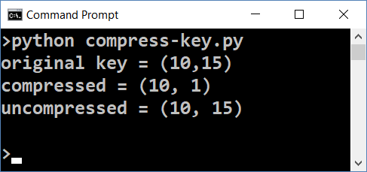
Compressing a Public Key in Python (2)
curve = CurveFp(17, 0, 7)
p = Point(curve, 10, 15)
print(f"original key = {p}")
compressed_p = compress_key_pair(p)
print(f"compressed = {compressed_p}")
restored_p = uncompress_key(curve, compressed_p)
print(f"uncompressed = {restored_p}")

Slide 52
ECC Parameters and secp256k1
ECC operates with a set of EC domain parameters:
T = (p, a, b, G, n, h)
Prime field (prime p), elliptic equation (a, b), base point G(x_{G}, y_{G}), order of G (prime n), cofactor (h)
The secp256k1 standard (used in Bitcoin) defines 256-bit elliptic-curves cryptosystem:
Prime field (p) = 2²⁵⁶ - 2³² - 977; Equation: y² = x³ + 7 (a = 0, b = 7)
G = 0x79BE667E …; n = 0xFFF…D0364141; h = 1
Learn more at: http://www.secg.org/sec2-v2.pdf, https://en.bitcoin.it/wiki/Secp256k1

Slide 53
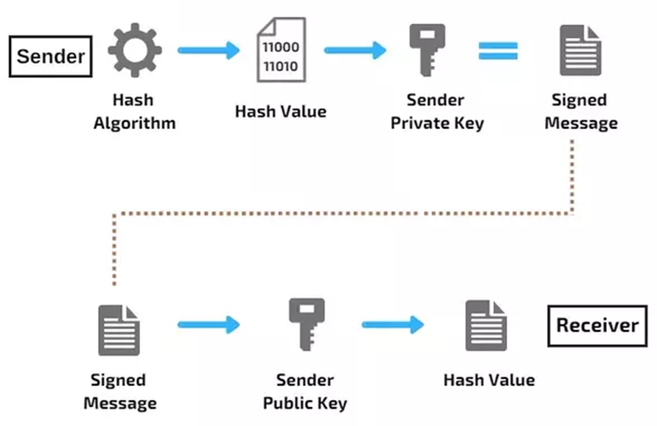
What is a Digital Signature?
Digital signature
Cryptographic prove for message authenticity
Authentication
Signed by certain private key
Verified by the corresponding public key
Non-repudiation
The sender cannot deny the signing later
Integrity
The message cannot be altered after signing

Slide 54
ECDSA: Sign Messages and Verify Signatures
The Elliptic-Curves Digital Signature Algorithm (ECDSA) provides signing by private key + verifying signature by public key
Signing a message
sign(private_key, msg) → signature (the signature is EC point)
Performs some math, based on elliptic curve calculations
Verifying a message signature
verify(public_key, msg, signature) → true / false
Performs some math, based on elliptic curve calculations

Slide 55
Example: ECDSA in Python – Sign a Message
from pycoin.ecdsa import generator_secp256k1, sign, verify
import hashlib
def keccak_hash(msg) :
hash_bytes = hashlib.sha3_256(msg.encode("utf8")).digest()
return int.from_bytes(hash_bytes, byteorder="big")
msg = "some message"
msg_hash = keccak_hash(msg)
private_key = 9999999999999999999999999999999999999999999
signature = sign(generator_secp256k1, private_key, msg_hash)
print("signature = " + str(signature))

Slide 56
Example: ECDSA in Python – Verify a Signature
public_key = (generator_secp256k1 * private_key).pair()
print("public key: " + str(public_key))
valid = verify(generator_secp256k1,
public_key, msg_hash, signature)
print("Signature valid? " + str(valid))
tampered_msg_hash = keccak_hash("tampered msg")
valid = verify(generator_secp256k1, public_key,
tampered_msg_hash, signature)
print("Signature (tampered msg) valid? " + str(valid))

Slide 57
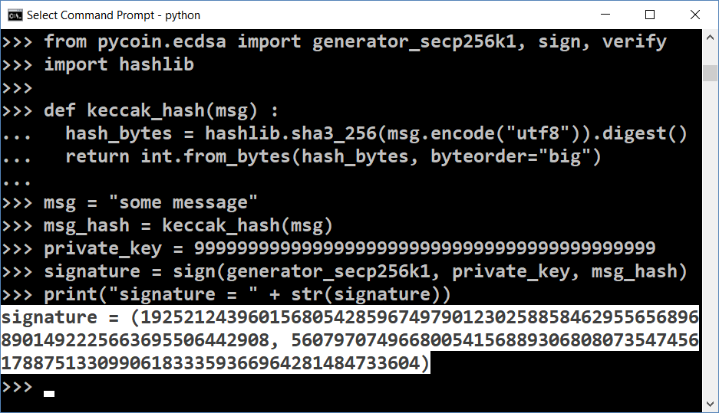
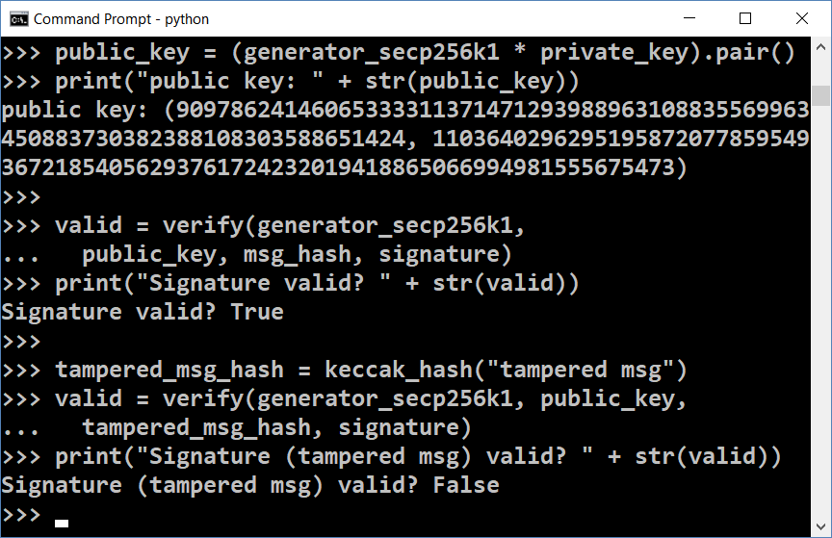
ECDSA: Sign / Verify Signature
Live Demo

Slide 58
Public / Private Keys, Wallets & Blockchain
wallet root key (seed)
private key
public key
address
signed transaction
transaction data
transaction
sign by private key
public key: (x, y)
signature: (r, s)
signed transaction
verify by public key
valid / invalid

Slide 59
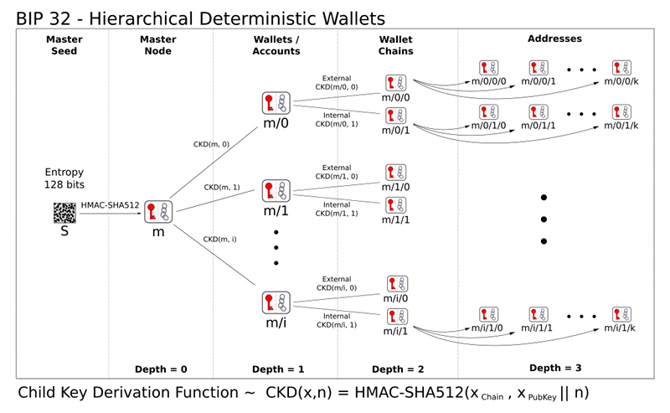
ECC and Wallets: BIP32
The BIP-32 standard defines how a crypto-wallet can generate multiple addresses
The wallet is initialized by a 256-bit root key (seed)
ECC math is used to generate multiple accounts
Through a derivation path
E.g. m/44'/60'/1'/12
Each account holds private key → public key → address

Slide 60
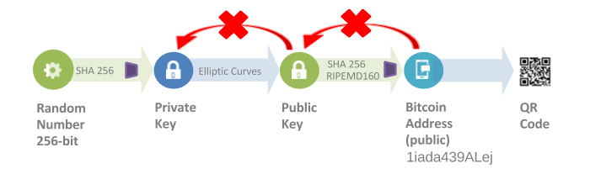
Generating a Bitcoin Address
Wallet seed S / CSPRNG → private key k → pubic key P → WIF compressed public key W → RIPEMD160(SHA256(W)) → Address A

Slide 61
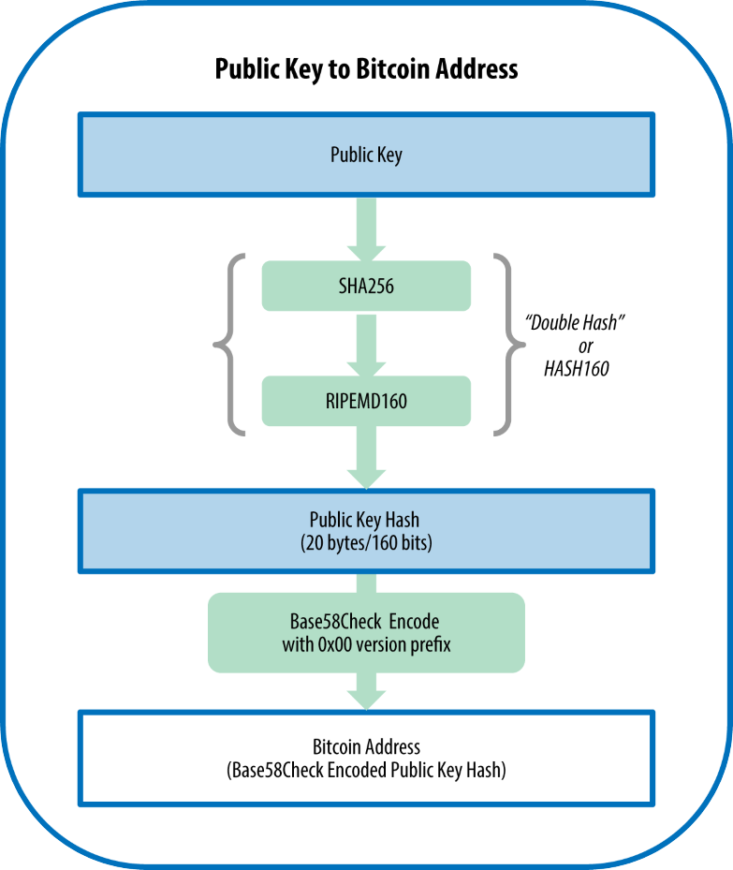
Public Key → Bitcoin Address
Generate random private key
Derive the public key from it
Compress the public key
Calculate SHA256
Calculate RIPEMD160
Calculate Base58check (Base58 encode with checksum)

Slide 62
Generate Bitcoin Address in Python (2)
pip install bitcoin
import bitcoin, hashlib, binascii
def generate_random_private_key():
while True:
key = bitcoin.decode_privkey(bitcoin.random_key(), 'hex')
if 0 < key < bitcoin.N: return key
def private_key_to_public_key(private_key):
return bitcoin.fast_multiply(bitcoin.G, private_key)
def pubkey_to_address(pubkey, magic_byte=0):
sha256value = hashlib.sha256(binascii.unhexlify(pubkey)).digest()
ripemd160value = hashlib.new('ripemd160', sha256value).digest()
return bitcoin.bin_to_b58check(ripemd160value, magic_byte)

Slide 63
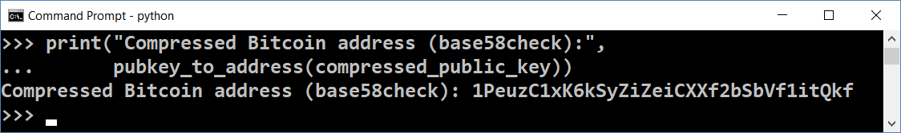
Generate Bitcoin Address in Python
private_key = generate_random_private_key()
print("Private key (decimal): ", private_key)
public_key = private_key_to_public_key(private_key)
print("Public key (x,y) coordinates:", public_key)
compressed_public_key = bitcoin.compress(public_key)
print("Public key (hex compressed):", compressed_public_key)
print("Compressed Bitcoin address (base58check):",
pubkey_to_address(compressed_public_key))

Slide 64
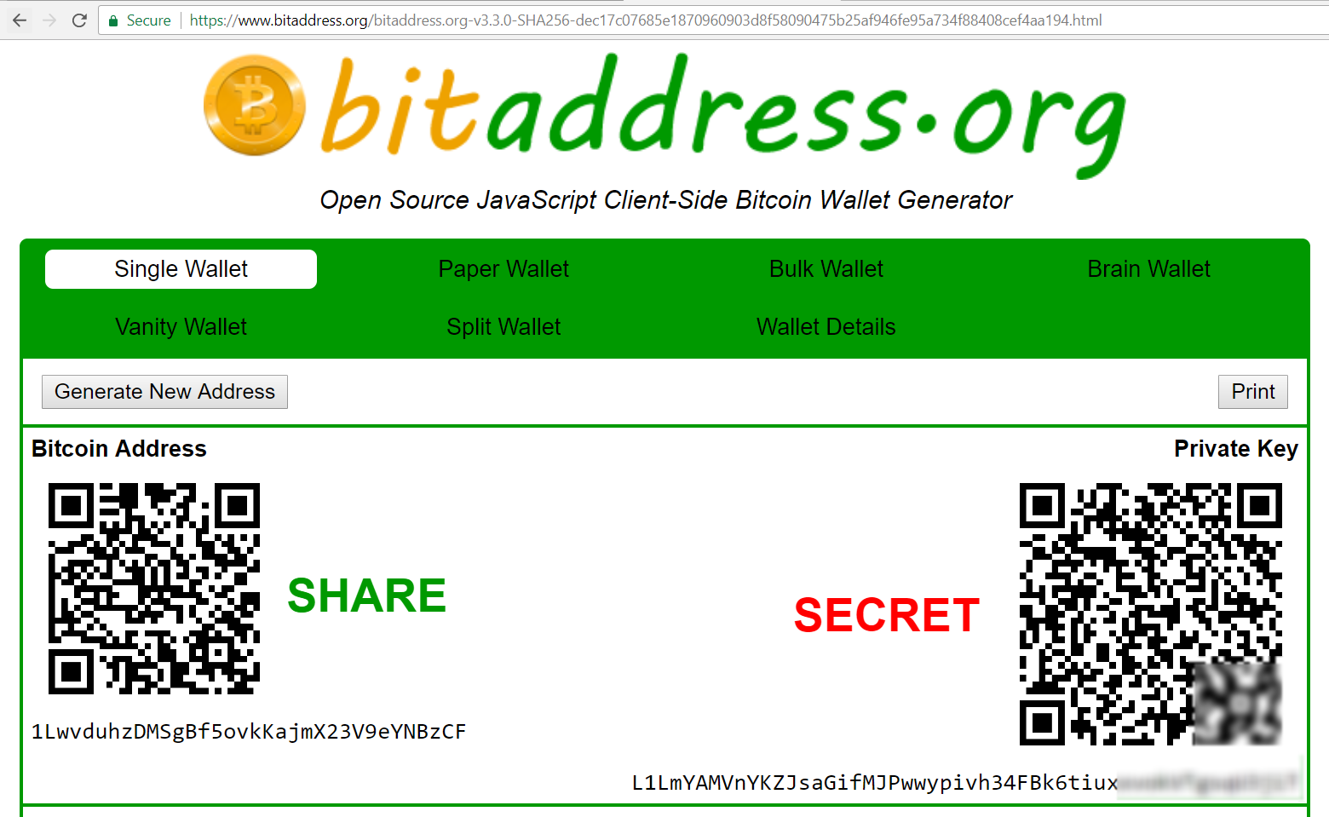
Live Demo
Generate a Bitcoin Address: https://www.bitaddress.org

Slide 65
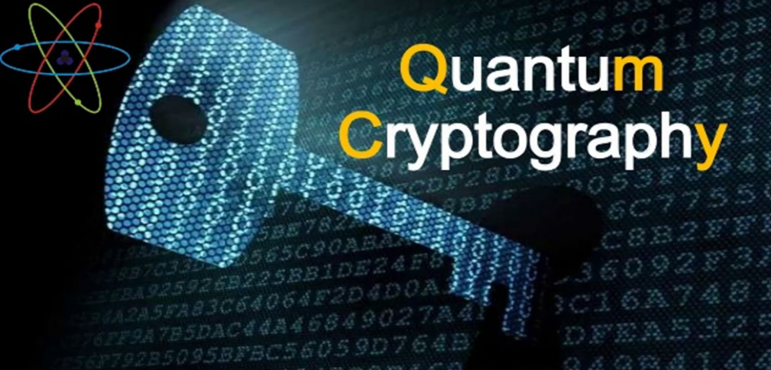
Post-Quantum Cryptography
Quantum-Resistant Crypto Algorithms

Slide 66
ECC Cryptography is not Quantum Resistant
A k-bit number can be factored in time of order O(k^3) using a quantum computer capable of storing 5k+1 qubits
See http://www.theory.caltech.edu/~preskill/pubs/preskill-1996-networks.pdf
256-bit number (e.g. Bitcoin private key) can be factorized using 1281 qubits in 72*256^3 quantum steps
~ 1.2 billion operations
~ less than 1 second in good machine

Slide 67
TODO

Slide 68


Exercises
Calculating Hashes and Bitcoin Addresses

Slide 69
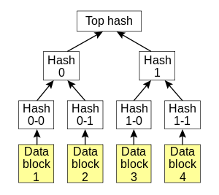
Merkle Tree
Leaf node == data block
Non-leaf node == cryptographic hash of its child nodes
Efficient and secure verification
Designed to ensure blocks of data can be received from other peers in a peer-to-peer network

Slide 70
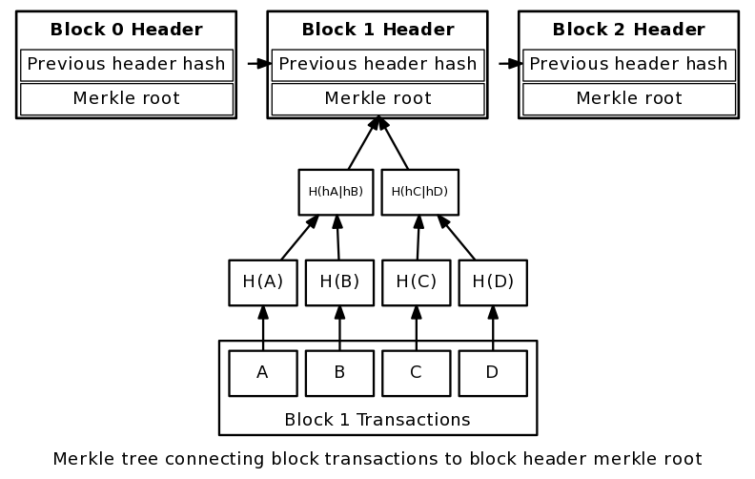
Blockchain and Merkle Trees
Merkle root
The hash of the hashes of all transactions in the block
Block header
Includes also the hash of the previous block’s header
Thus chaining the blocks together
Hashed with the PoW value

Slide 71

Summary
Cryptography is a method of storing and transmitting data in a secure way
Public / private key cryptography is widely used in the blockchain technologies
RSA is public key cryptosystem: encrypt / decrypt
Cryptographic hash function is one-way function, irreversible, little collisions
Examples: SHA-256, RIPEMD-160, SHA-3
ECDSA is elliptic curve cryptosystem: sign / verify

Slide 72
Blockchain Cryptography
http://www.kingsland.academy

Slide 73
Resources
Diffie-Hellman Key Exchange –en.wikipedia.org/wiki/Diffie%E2%80%93Hellman_key_exchange
Elliptic Curves Cryptography: https://eng.paxos.com/blockchain-101-elliptic-curve-cryptography
ETHash – https://github.com/ethereum/wiki/wiki/Ethash
Merkle Tree – https://en.wikipedia.org/wiki/Merkle_tree
Bitcoin Address: https://github.com/bitcoinbook/bitcoinbook/blob/second_edition/ch04.asciidoc

